Slide 1
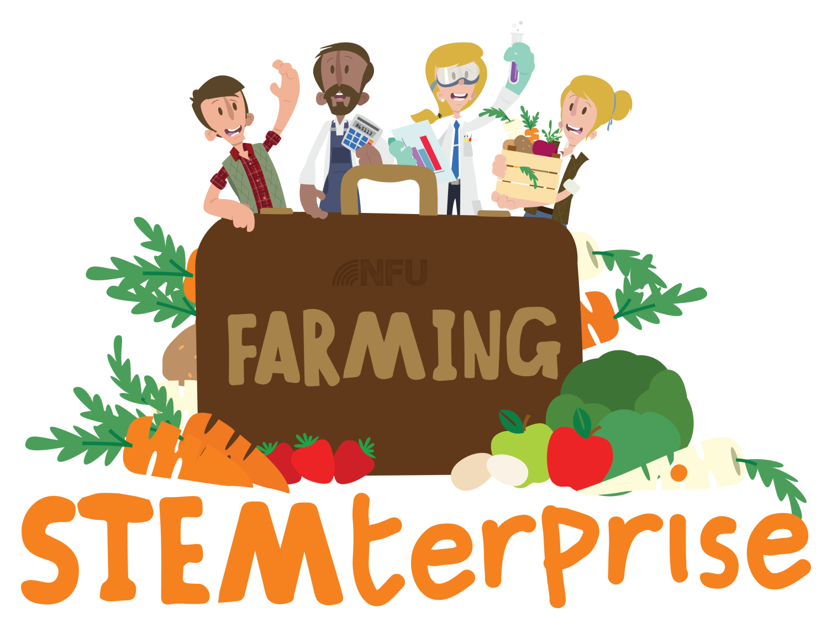
Introduction

Slide 2
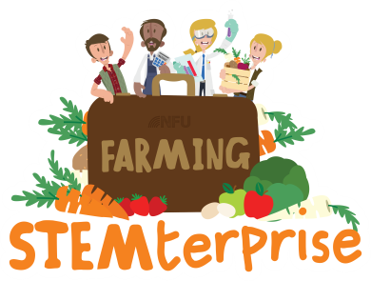
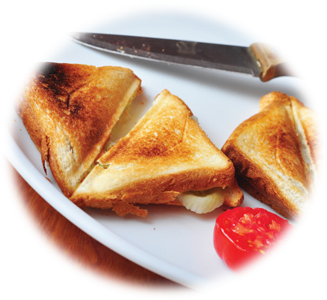
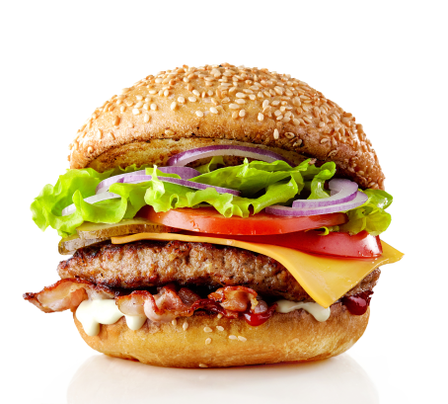
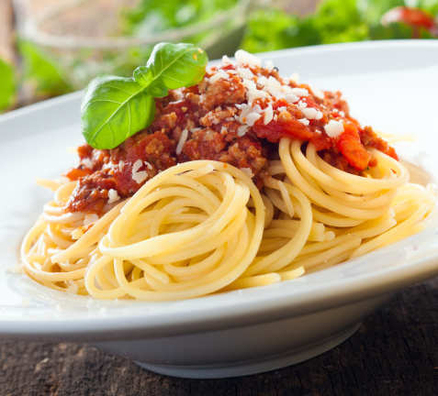
The Challenge!
Year 6!
The people of the UK need your help!
Every day, they peer hopefully through the windows of their local restaurants only to be greeted by the same old offerings: bland burgers, tasteless toasties and yet another plate of slimy spaghetti!
We are giving YOU the task of setting up your own farm restaurant to design and make a range of themed dishes to save the people of the UK from their mealtime boredom.
Good luck!

Slide 3
Setting up your farm restaurant business
When setting up a business, entrepreneurs need to consider lots of factors.
What do you think these might be? Talk to your group!
Notes:
Possible answers: What product/s to sell, how much to charge, where they should sell them (stall, shop, website), who do we want to buy them?

Slide 4
Marketing
“Marketing is influencing behaviour to persuade people to buy more of your products, more often, for more money.”
Mark W. Schaefer
“Marketing is products that don’t come back and consumers that do.”
Steve Dawson
What do you think these quotes mean?

Slide 5
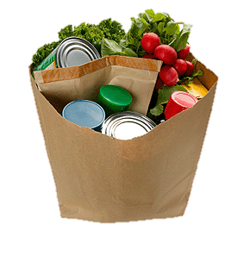
Think…
When you go into a supermarket, what influences the products that you and your parents choose to buy?

Slide 6
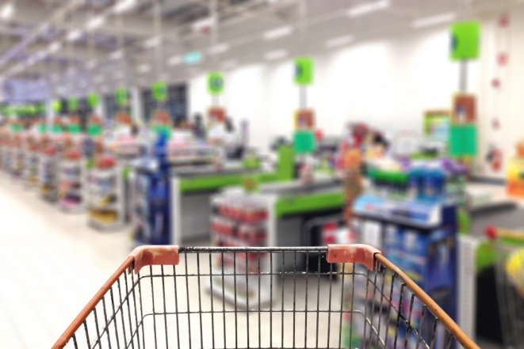
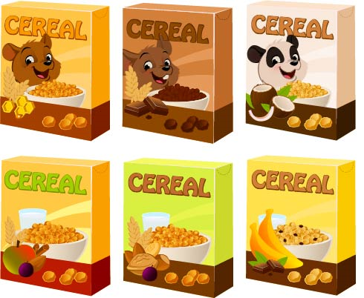
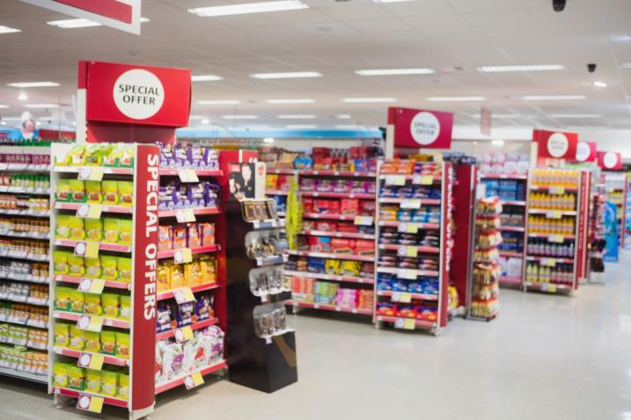
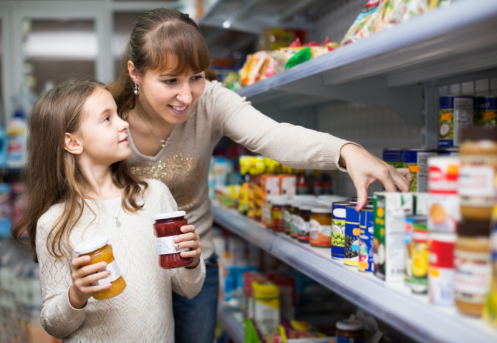

Slide 7
The 4 Ps of Marketing
When planning their marketing strategy, businesses need to consider 4 main factors:
Product
Price
Promotion
Place

Slide 8
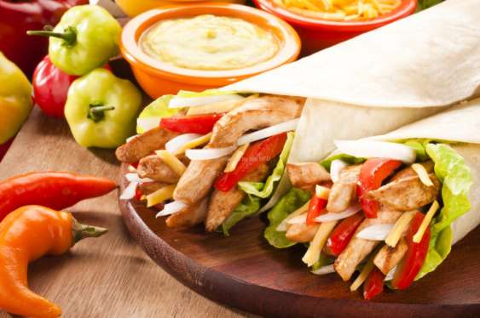
Product
A product is anything that satisfies a customer’s need.
Your product will be a range of healthy, balanced meals using your chosen star ingredient.
When designing a product, businesses need to make sure they stand out from their competitors and offer something new and exciting.

Slide 9
Branding
One way of standing out from the competition is to create a strong brand with a memorable logo.

Slide 10
Branding
Task 1: Talk to your business group and start to think about a name for your new business.
Task 2: Design your company logo.

Slide 11
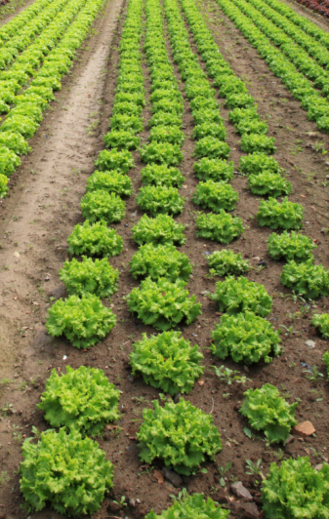
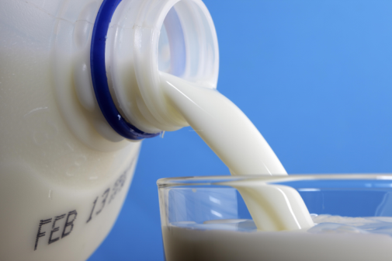
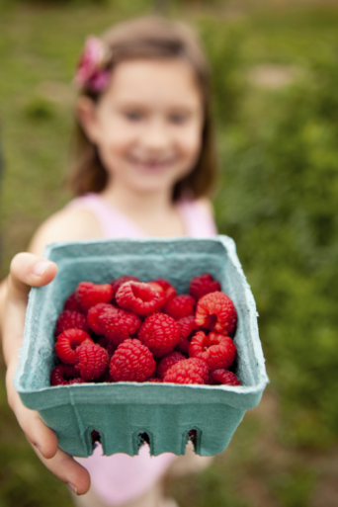
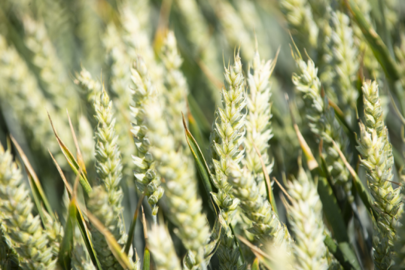
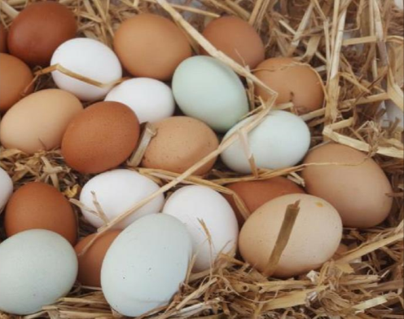
Where does our food come from?

Slide 12
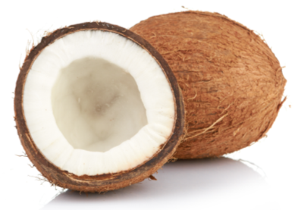
A lot of the food we eat is grown and reared in the UK by farmers
Talk to your business group: how many British foods can you name?
Why can’t we grow all types of fruit and vegetables in the UK?

Slide 13
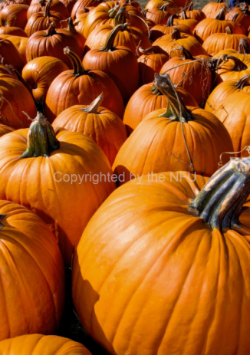
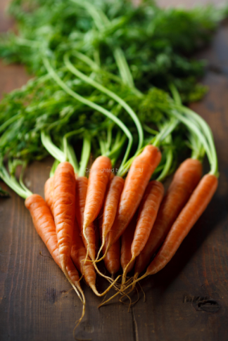
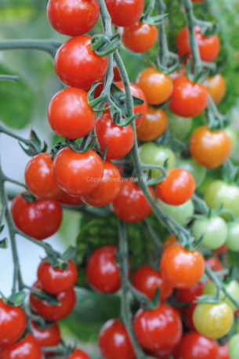
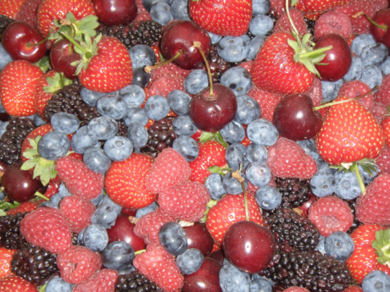
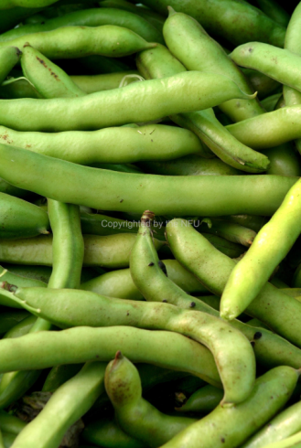
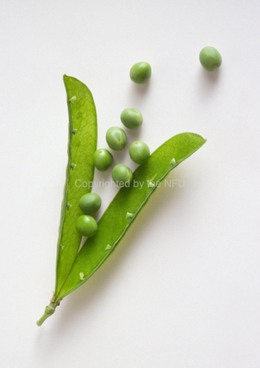
Examples of British fruit and vegetables:
Lettuce
Tomatoes
Radishes
Carrots
Beans
Peas
Spinach
Pumpkins
Cucumbers
Radishes
Strawberries
Blackberries
Rhubarb

Slide 14
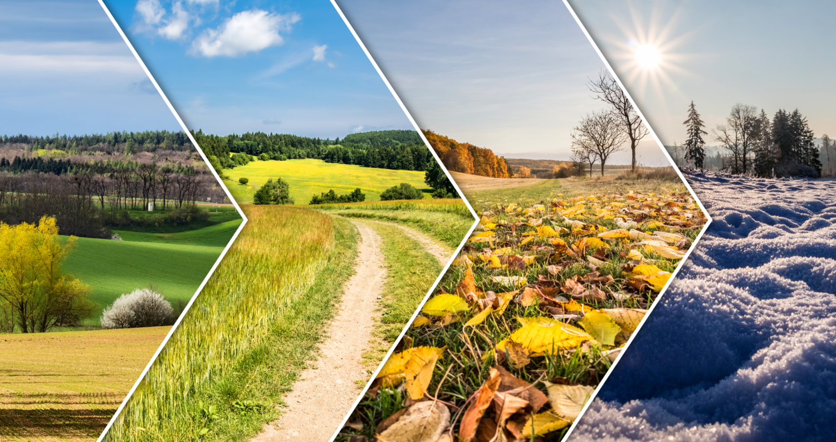
Seasonality
Different fruit and vegetables grow and can be harvested at different times of the year.
Eating foods when they are in season means that we can support British farmers and growers by buying their produce.
Ingredients that have been grown in this country do not have to travel as far to reach our plates and so they are also better for the environment because they reduce the need for transport, reducing air pollution

